Slide 1
Full Stack Application Development
Server Side: Implementing Web Services
gRPC
gRPC- Message Encoding
Akshaya Ganesan

Slide 2
gRPC-Message encoding

Slide 3
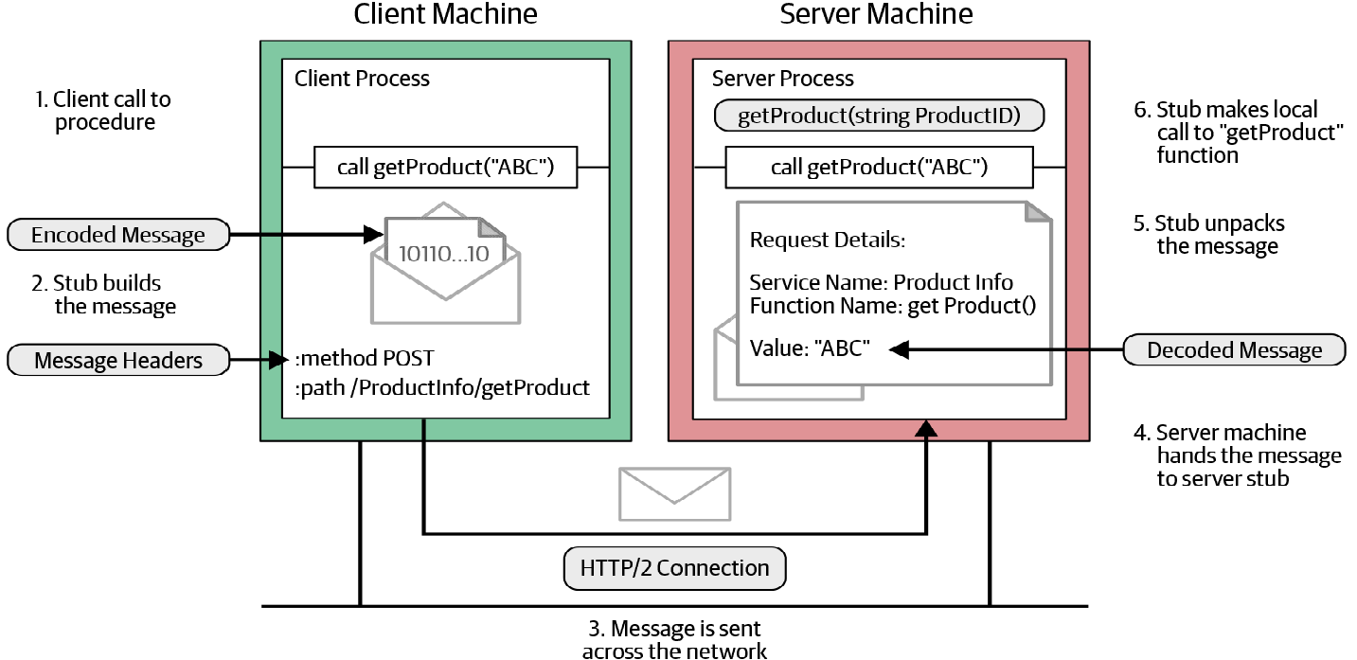
gRPC- Flow
Image Source: gRPC: Up and Running by Kasun Indrasiri, Danesh Kuruppu

Slide 4
Message Encoding
message ProductID
{
string value = 1;
}
Let’s say we need to get product details for product ID 15;
Message Field
Tag | Value

Slide 5
Message Encoding
Tag value = (field_index << 3) | wire_type
Wire type
0 for Varint int32, int64, uint32, uint64, sint32, sint64, bool, enum
1 for 64-bit fixed64, sfixed64, double
2 for Length-delimited string, bytes, embedded messages, packed repeated fields
3 for Start group groups (deprecated)
4 for End group groups (deprecated)
5 for 32-bit fixed32, sfixed32, float
Tag value = (00000001 << 3) | 00000010
= 000 1010

Slide 6
Length-Prefixed Message Framing
gRPC uses a message-framing technique called length-prefix framing.
Length-prefix is a message-framing approach that writes the size of each message before writing the message itself.

Slide 7
gRPC over HTTP/2
gRPC uses HTTP/2 as its transport protocol to send messages over the network.
This is one of the reasons why gRPC is a high-performance RPC framework.
The gRPC channel represents a connection to an endpoint, which is an HTTP/2 connection.
Messages that are sent in the remote call are sent as HTTP/2 frames.
A frame may carry one gRPC length-prefixed message, or if a gRPC message is quite large it might span multiple data frames.

Slide 8
gRPC Flow
gRPC Message Encoding
Length Prefix Message Framing
gRPC over HTTP/2

Slide 9
Thank You!

